Slide 1
Insulating materials based on silica aerogel composites: synthesis, properties and application

Slide 2
Introduction
• Aerogels have acquired popularity as insulation materials due to their outstanding qualities such as great thermal insulation, flame retardancy, lightweight construction, and environmental friendliness
• In particular, silica aerogels are emerging as game changers in the construction insulation sector, accounting for a sizable proportion due to their low thermal conductivity and simplicity of manufacture
• This paper gives a through overview of silica aerogel production processes, the key qualities necessary for aerogel-based composites, and the more recent advances in their use in building insulation
• It also examines how to overcome inherent obstacles such as mechanical fragility and high manufacturing costs, providing technologies that improve mechanical strength and long-term durability

Slide 3
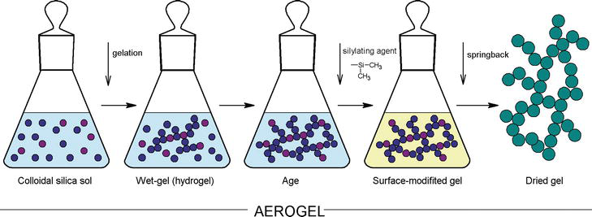
Synthesis
• The production of silica aerogels involves the key steps below:
Formation of the Sol and Gelation Process
Silica sol is formed using the sol-gel method, involving hydrolysis and condensation of silicon alkoxides like TMOS and TEOS
Acid-catalyzed reactions facilitate hydrolysis, base-catalyzed reactions produce highly condensed structures
Gelation occurs when primary nanoparticles aggregate into clusters forming a continuous network resembling a pearl necklace
2. Aging of the Gel
Post-gelation, slow hydrolysis and condensation continue, strengthening the silica network
Processes like neck development and Ostwald ripening enhance the gel’s structural integrity
Immersion in silane precursors during aging improves cross-linking and prevents cracking during drying

Slide 4
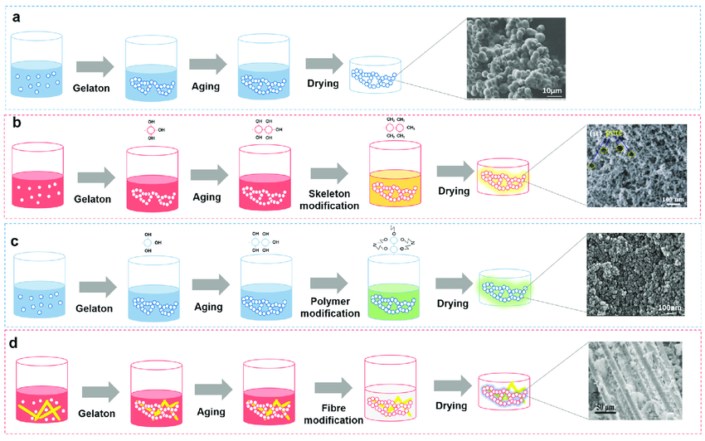
Synthesis
• The production of silica aerogels involves the key steps below:
3. Washing the Gel
The gel is washed to remove impurities, unreacted precursors, and catalysts
Washing typically involves solvent exchangers using pure alcohol to prevent collapse of the porous structure
4. Drying of the Gel
Critical to preserving the gel’s porous structure, drying minimizes damage from capillary forces
Three drying techniques:
- Ambient pressure drying (APD): Simple and cost-effective but requires surface modification to prevent shrinkage
- Supercritical drying (SCD): Preferred for maintaining pore integrity and preventing collapse
- Freeze drying (FD): Produces aerogel powders but risks damage from ice crystal formation

Slide 5
Required properties of silica aerogel composites as insulation materials
1. Thermal conductivity
- The most critical property for insulation materials.
- Low thermal conductivity is achieved through a combination of solid conduction, gaseous conduction, and radiative transmission
Effective thermal conductivity depends on the aerogel’s lattice structure, pore connectivity, and granule size
2. Mechanical strength
- A key factor for the durability and applicability of aerogel composites in construction
- Silica aerogels are inherently fragile due to their high porosity and network structure
Mechanical strength can be enhanced through composite designs, incorporating fibers or polymers matrices
3. Acoustic Insulation
- Porous structures of silica aerogels contribute to effective sound absorption, reducing noise transmission
- Acoustic performance is influenced by synthesis conditions and additives used in the aerogel matrix

Slide 6
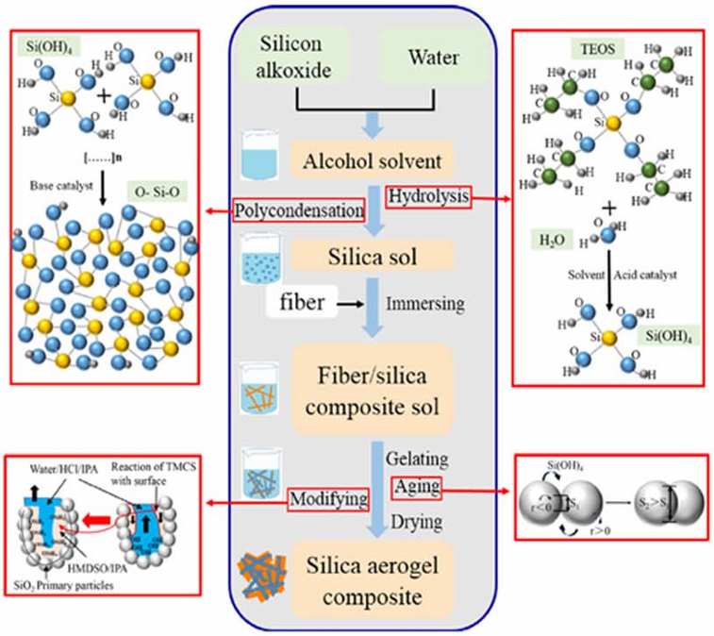
Classification and application of silica aerogel-based composites
Composites are categorized based on the matrix used:
• Aerogel-Fiber Composites
Combine silica aerogels with fibers like glass, carbon, or silicon carbide to enhance mechanical strength and thermal insulation
Fibers enhance the skeletal support of the aerogels and limit crack propagation
In-situ composite formation: the fiber is submerged in a sol-gel solution, which is later dried to form the composite
Secondary compression molding: Silica is prepared first and then combined with fibers using additives and thermal compression
It is suitable for environmental requiring lightweight materials with high thermal resistance
Optimizing the balance between aerogel and fiber content is crucial for achieving both mechanical and thermal efficiency
Recent research focuses on improving hydrophobicity and resistance to environmental factors like moisture

Slide 7
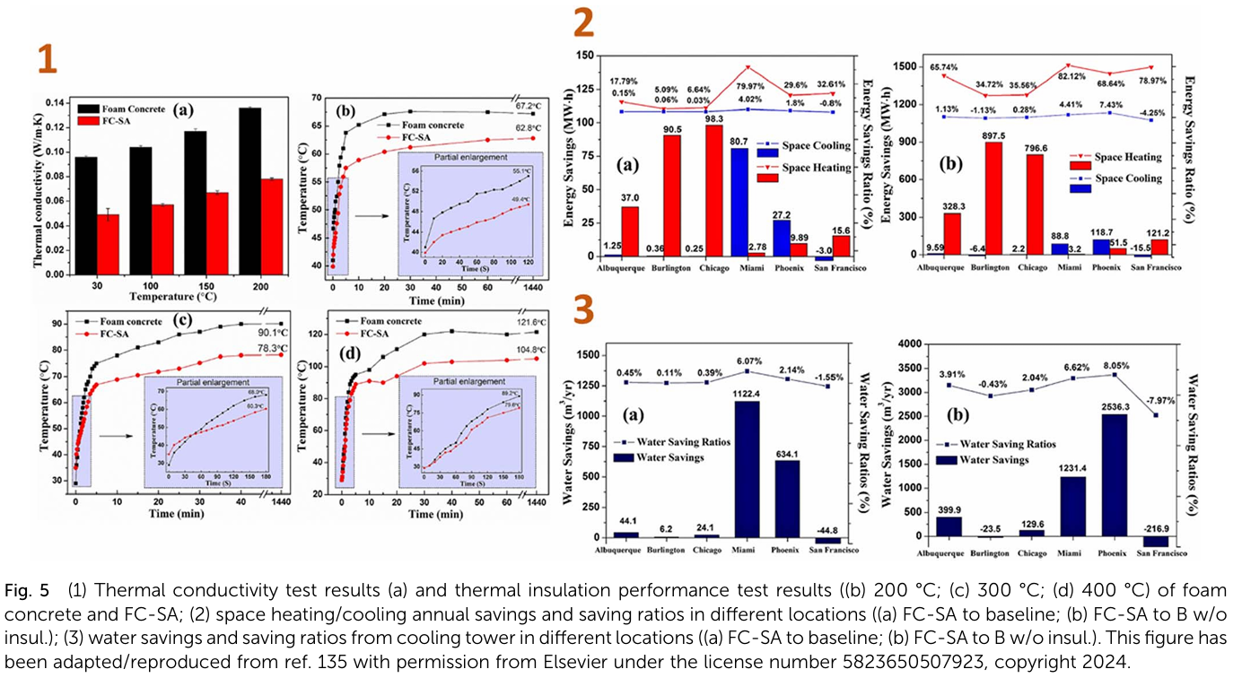
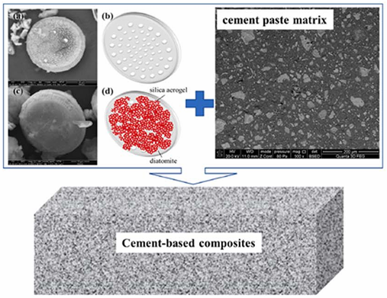
Classification and application of silica aerogel-based composites
Composites are categorized based on the matrix used:
• Aerogel-Cement Composites
Aerogels are commonly utilized as aggregates and fine fillers in cementitious composite materials such as lightweight cement, foamed concrete, and mortar to reduce heat transfer while maintaining mechanical stability
Aerogel concrete with good mechanical characteristics can be utilized as a structural element, whereas mortar and foamed concrete can be used as a thermal insulating layer, plaster, block or panel
Aerogel is often utilized as a volumetric replacement of fine aggregates, as well as a partial replacement of fine/coarse aggregates ranging from 0% to 60% by volume in cementitious composites
Recent research focuses on improving hydrophobicity, reducing production costs, and optimizing aerogel content to balance insulation and strength

Slide 8
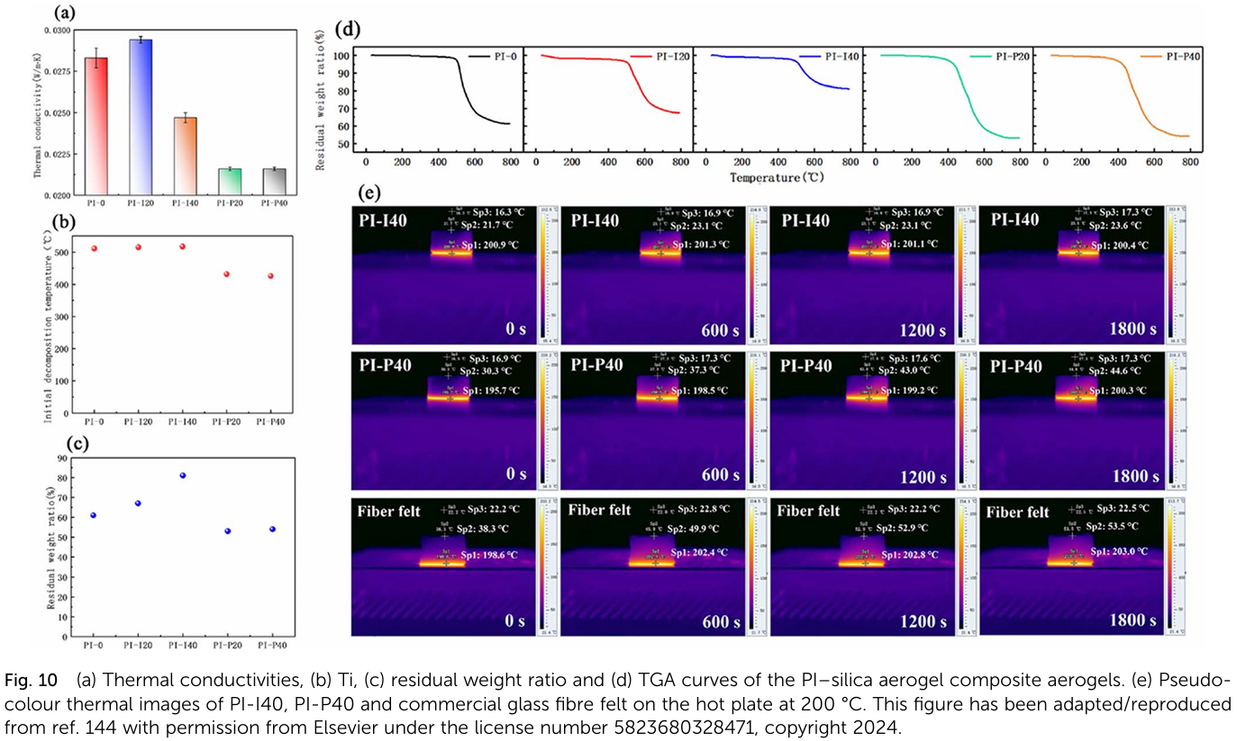
Classification and application of silica aerogel-based composites
Composites are categorized based on the matrix used:
• Aerogel-Polymer Composites
To enhance the mechanical, thermal, and chemical properties of aerogels by embedding them in polymer matrices
This approach improves durability, flexibility, and usability across various applications
Silica aerogels are combined with polymers like polyurethane, polyimide, or epoxy using techniques such as blending, in-situ polymerization, or extrusion
Customizable properties by varying aerogel-polymer ratios and surface treatments
Recent research focus on developing cost-effective production methods, enhancing compatibility between aerogels and polymers for optimized properties, and exploring eco-friendly and biodegradable polymers

Slide 9
Conclusion
• Silica aerogels have emerged as revolutionary materials in insulation, offering excellent thermal insulation properties, lightweight structures, and environmental benefits.
• Thus, this paper addressed current achievements in incorporating silica aerogels into composites and building constructions.
• The thermal conductivities vary between 0.014 and 0.026 W/mK when the aerogel is applied in the form of vacuum insulation panels or blankets and can be up to one order of magnitude higher when the aerogel is incorporated in cement, mortars or concrete, with the increase obviously dependent on the amount of aerogel in the mixture.
• In general, the addition of aerogels to various construction materials results in significant decreases in composite densities and thermal conductivities when compared to systems without aerogels.
• But the compressive strengths of composites decrease as the content of silica aerogels increases, so the search for the optimal quantity of aerogel is required in this circumstance.
• Given the foregoing, we may infer that silica aerogel-based composites have a high potential for use in the construction and building industries due to their unique features and availability.

